Slide 1
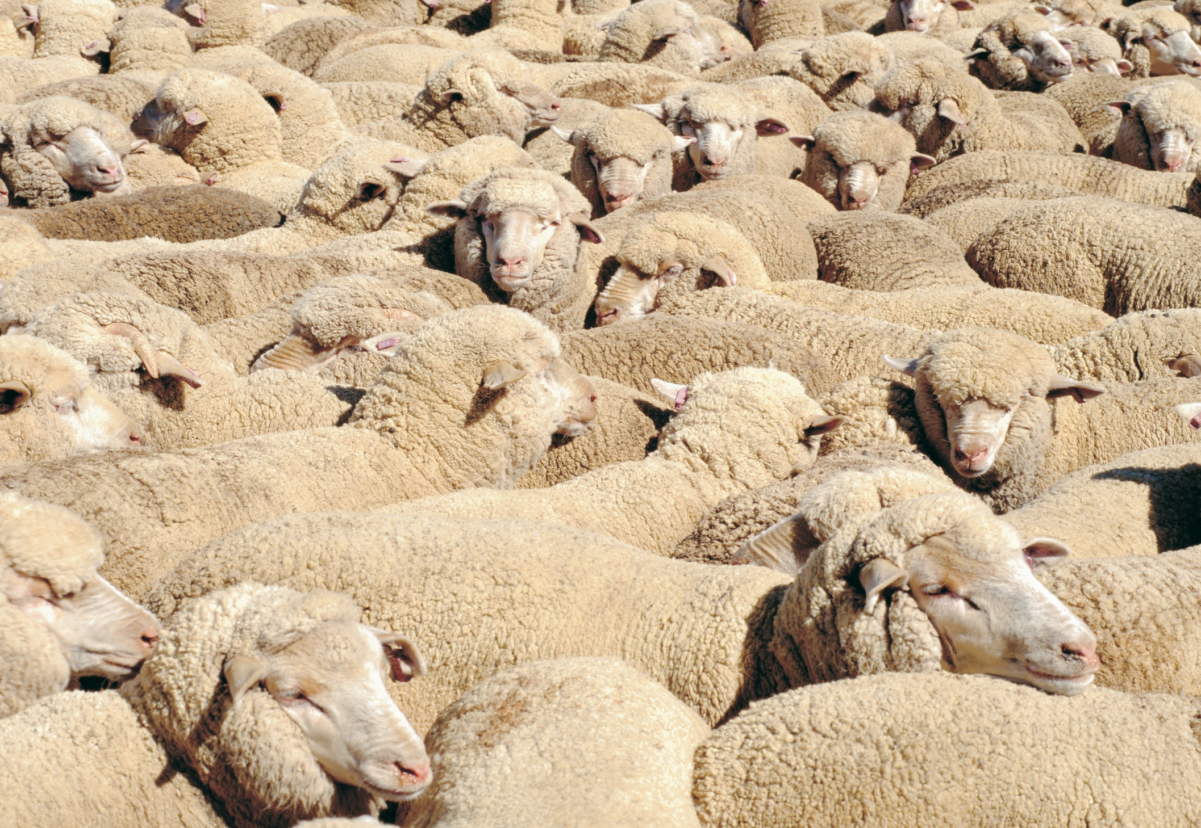
Accounting for Carbon
Notes:
National emissions
On-line tools
Difference between product intensity and total emissions

Slide 2
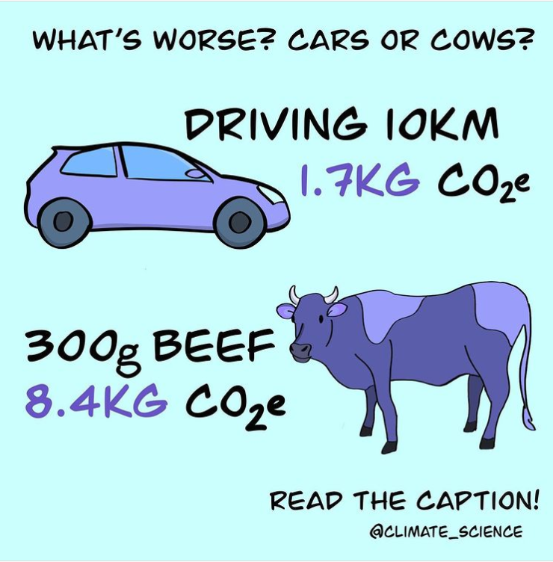
Notes:
Assumes 28t CO2 e per tonne beef. WA figures show 12-17 t CO2/t beef up to slaughter. Add 10% for processing, transport and packaging. 13- 19 tonnes CO2 e/t or 3.9 – 5.4 kg/kg of beef

Slide 3
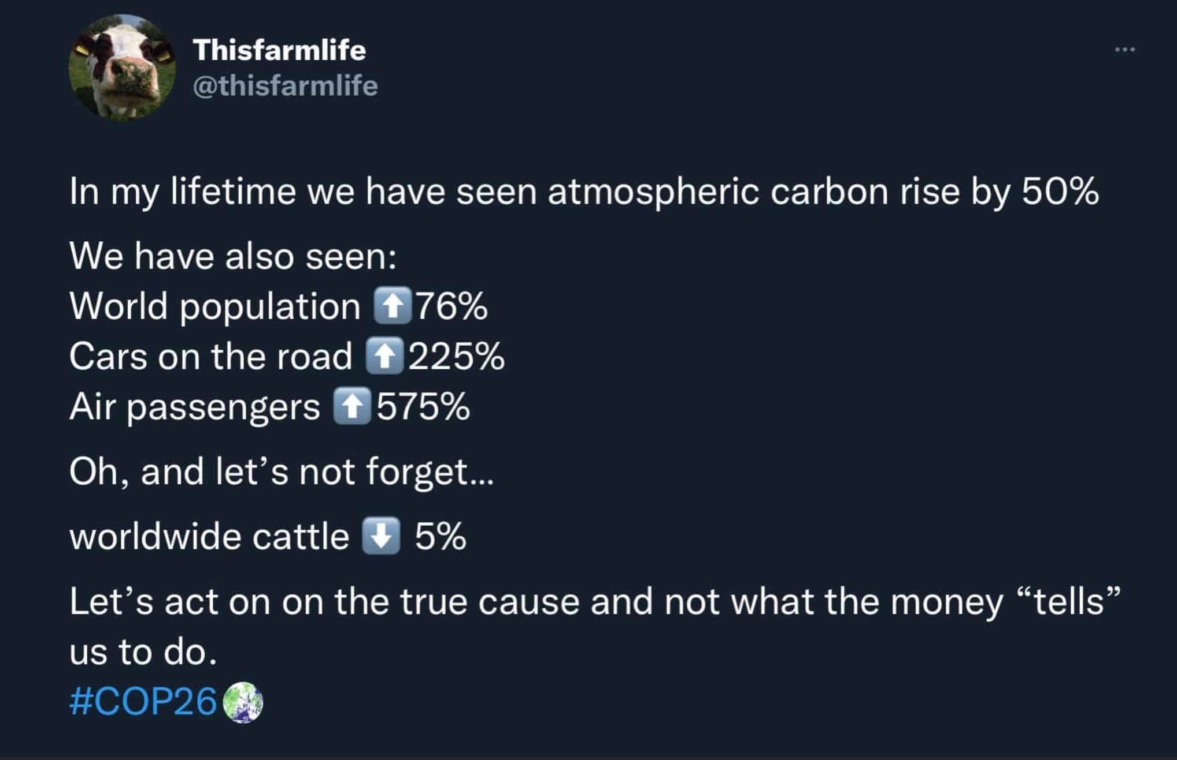

Slide 4
How do we measure Carbon emissions?
Global Warming Potential (GWP) Values
Not all gases are the same:
1tonne of CO2 = 1 tonne of CO2 e-
1 tonne of CH4 = 28 tonnes of CO2 e-
1 tonne of N20 = 265 tonnes of CO2 e-
National/state emission inventories - direct emissions by emission source and sector (eg energy, waste, agriculture)
Life Cycle Assessment – usually from inception including all input through to sale of the product, including processing and transport.
Business/farm Carbon Accounts include all levels of emissions to the point of export from the farm gate.
Scope 1 - emissions that occur on site e.g. enteric methane, CO2 from diesel
Scope 2 - electricity emissions
Scope 3 – emissions associated with purchased inputs
From https://www.ghgprotocol.org/sites/default/files/ghgp/Global-Warming-Potential-Values%20%28Feb%2016%202016%29_1.pdf

Slide 5
National Greenhouse Gas Inventory reporting
WA GHG Emissions

Slide 6
National Greenhouse Gas Inventory reporting
Notes:
*Direct soil emissions include microbial nitrification and denitrification of fertiliser and manure nitrogen that remains in agricultural soils.
Indirect soil emissions involve nitrogen that is removed from agricultural soils via volatilisation, leaching, runoff, or harvest of crop biomass.
** Liming and urea application takes into account the loss of CO2 that was fixed during the manufacturing process or dissolution process.
CO(NH2)2, manufactured via the reaction of ammonia (NH3) and carbon dioxide (CO2) at high pressure and temperature.

Slide 7
Notes:
Liming about 21% of cropland emissions

Slide 8
National Greenhouse Gas Inventory reporting

Slide 9
National Greenhouse Gas Inventory reporting
Notes:
Industry at least doubled in value over the time
While livestock numbers and emissions have nearly halved

Slide 10
Land Use Land USE Change (LULUC)

Slide 11
Questions around LULUC – what are the big levers?
Sector (soil & veg C stocks WA 2019 Gg) | Source of emissions/sequestration
Forest remaining forest (1,095) | Fire
 | Degradation
 | Logging
Land converted to forest (- 7,075) | Perm woodland
 | Plantations
 | Shrublands
Cropland remaining Cropland - incl pasture and woody perennial horticulture (-5,541) | Crop type
 | Crop area and rotation
 | Stubble management
 | Tillage type
 | Green manures/legume crops
 | Soil ameliorants
 | Fertiliser application (excl N)
 | Biomass estimates
 | Clearing of orchards
Land to cropland (1,020) | ? Permanent pasture to crops?
Grassland remaining grassland - including high rainfall permanent pasture and pastoral grasslands (- 1,770) | Grazing intensity
 | Pasture management
 | Fertiliser application (excl N)
 | Irrigation
 | Seed selection
 | Biomass burning
 | Grazing intensity
Land to grassland (3,068) | Permanent pastures in high rainfall area
 | Clearing of sparse woody vegetation

Slide 12
What is a Life Cycle Assessment (LCA)?
LCA is a form of cradle-to-grave system analysis for a number of factors but often used for carbon and water impacts of a product
Usually reported in terms of emissions intensity of product (carbon footprint)
Can have any starting point or end point – depends on what the question is!
All emissions pre and on-farm production to the point of processing
All emissions for a product at the consumer check out
Comparing impact of a range of pre-farmgate inputs
Have been done for many products over the years but many are using older emissions factors
Good example is latest paper for GRDC by Maatje Sevenster CSIRO
Australian Grains Baseline and Mitigation Assessment

Slide 13
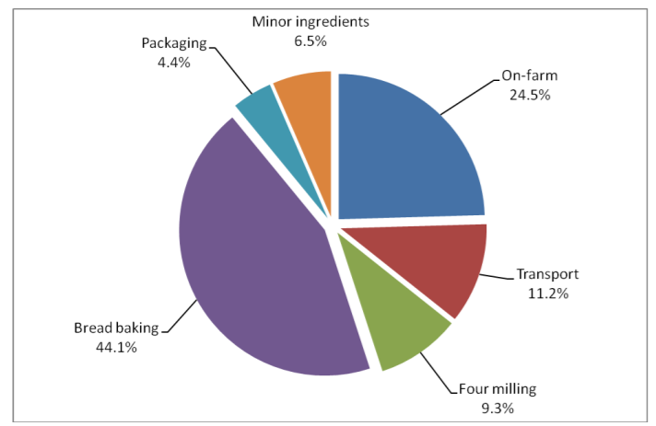
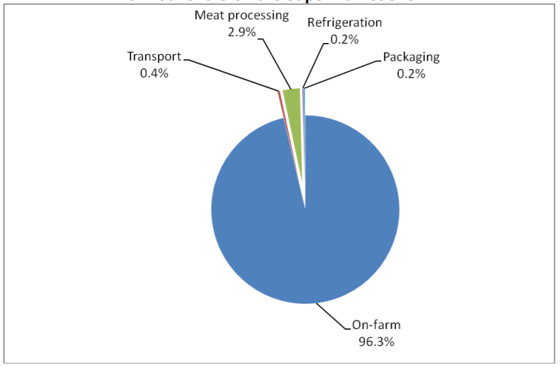
Relative contribution of the supply chain to the carbon footprint of fresh products on the supermarket shelf
Bread
Beef (fresh)
Relative contribution of sectors or the supply chain to the carbon footprint of fresh bread on the supermarket shelf – Eady et al

Slide 14
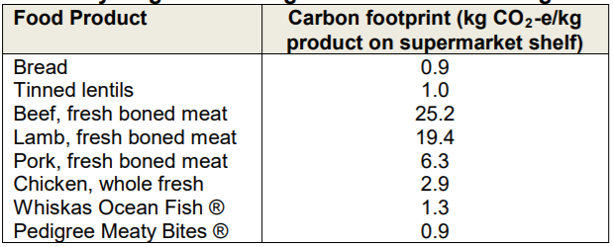
Fresh food GHG emissions at the supermarket
Meat consumed converted to live weight assuming meat yield of 40%.
Hot slaughtered carcass weight converted to live weight assuming 1.4 kg CO2-e/t HSCW for processing and 53% dressing percentage.
Meat consumed converted to live weight assuming meat yield of 64%.

Slide 15
On farm Carbon Accounting
A Carbon Account gives a business an account of the GHG emissions for that business and should include:
Scope 1 - emissions that occur on site e.g. enteric methane, CO2 from diesel
Scope 2 - electricity emissions
Scope 3 – emissions associated with purchased inputs
It gives an emissions value for the farm, emissions intensity of product (up to leaving the farm gate) and can give a value per hectare or per animal if required.
This is the most valuable step you can take – it is a benchmark, valuable for scenario testing, and setting direction of your business plan
Benchmark – see how your efficiency and overall emissions stack up with others in a similar production environment
Scenario testing- identifying hotspots of emissions and then seeing how changing practices will influence your carbon account
Inform your business plan – as a serious grower with an eye to future markets or as someone wanting some good cash to continue farming without participating (or making it harder to participate in) markets for low GHG products in the future.
A carbon account can be unofficial – use an on-line tool to see where you’re at
A carbon account can be official – have a consultant conduct an account and consider options of generating carbon credits – either to keep for your own business or to sell

Slide 16
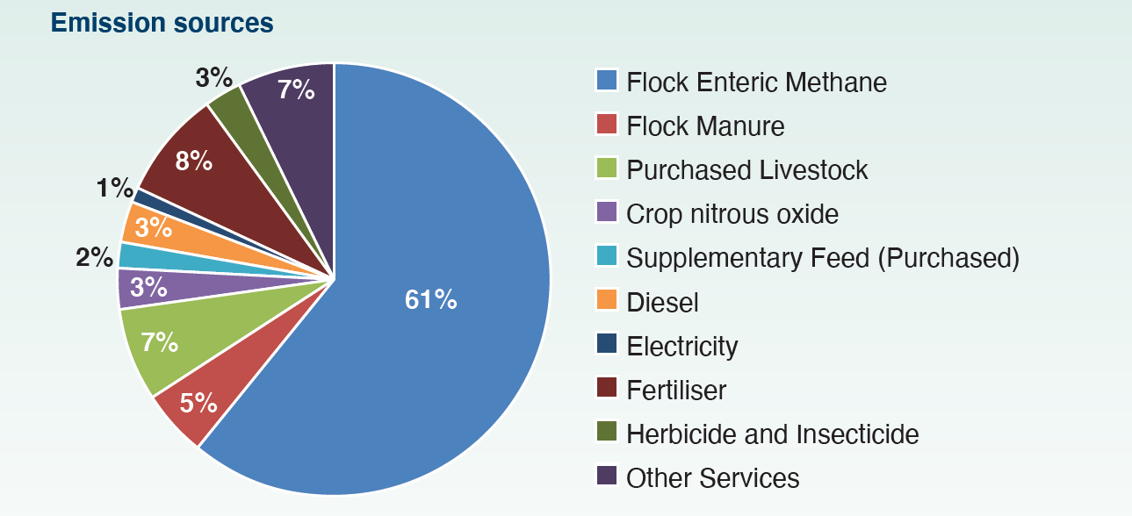
Katanning Research Facility
Emission intensity by land area
~1.5t CO2 e- per arable/grazed hectare per year
Proportion of emissions from Livestock activities
76% plus a portion of other services

Slide 17
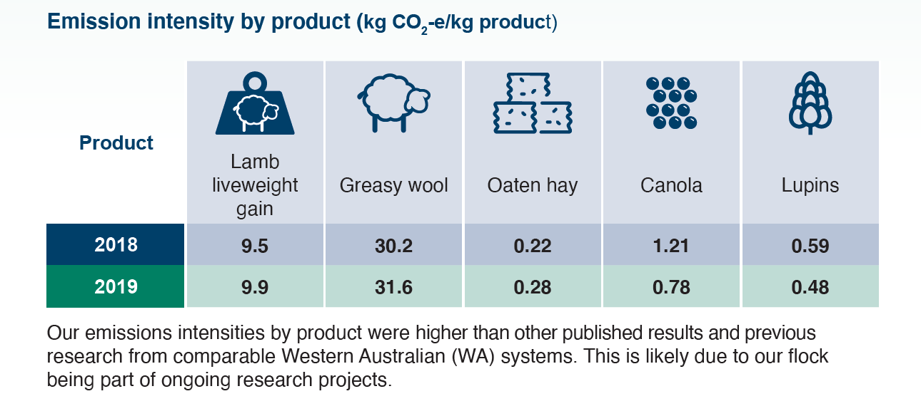
Some examples of other emissions intensity studies
Wool 20kg CO2e/kg of wool produced on farm in WA (Darkan) 250 CO2 e per DSE
Lamb 7.5-8kg CO2e/kg of live weight on farm in eastern Australia ~85% of total emissions is pre-farm gate Meat processing = 4-6%, Transport = 3-5%
Crops 0.22kg CO2-e/kg grain for a 3 t/ha wheat crop following wheat 0.20 kgCO2-e/ for wheat following canola
Notes:
Impacts for WA greasy wool = around 20 kg CO2-e / kg. sheep meat = 8.2-9.4 kg CO2-e / kg. Emissions per D.S.E = approx. 250kg CO2-e.
Brock etal: 225 kg carbon dioxide equivalents (CO2-e)/t grain for a 3 t/ha wheat crop following wheat, compared with 199 and 172 kgCO2-e/t for wheat
following canola and field peas, respectively

Slide 18
Carbon Accounting Tools for Producers
On-line tools for producers vary with some tools based on European parameters.
The G-GAF tool from Uni of Melbourne (www.piccc.org.au/resources/Tools) is recommended and aligns with Australian inventory parameters.
Worked examples using this tool are on DPIRD’s website (Carbon Calculators – Western Australian example farms)
 | Wheat | Barley | Pulses | Oilseeds | Sheep Meat | Sheep Wool
 | t CO2-e/t crop | t CO2-e/t crop | t CO2-e/t crop | t CO2-e/t crop | kg CO2-e / kg LW | kg CO2-e / kg greasy
E Wheatbelt 100% Cropping | 0.29 | 0.31 | 0.24 | 0.70
E Wheatbelt Mixed Farm | 0.29 | 0.31 | 0.24 | 0.70 | 8.10 | 29.40
Geraldton 100% Cropping | 0.36 | 0.41 | 0.26 | 0.88
Woolbelt Mixed Farm | 0.29 | 0.31 |  |  | 7.63 | 28.54

Slide 19
Useful and thought provoking podcasts
Bigger, faster, stronger, hotter, more frequent- resilient farming in the face of extreme weather- Part 1 by There's an Elephant in my Paddock! (anchor.fm)

Slide 20
Thank you
Contact: Mandy Curnow e: mandy.Curnow@dprird.wa.gov.au 08 98928444
For other information: agric.wa.gov.au//climate-change/livestock-and-carbon
Important disclaimer The Chief Executive Officer of the Department of Primary Industries and Regional Development and the State of Western Australia accept no liability whatsoever by reason of negligence or otherwise arising from the use or release of this information or any part of it.
© State of Western Australia 2021

Slide 21
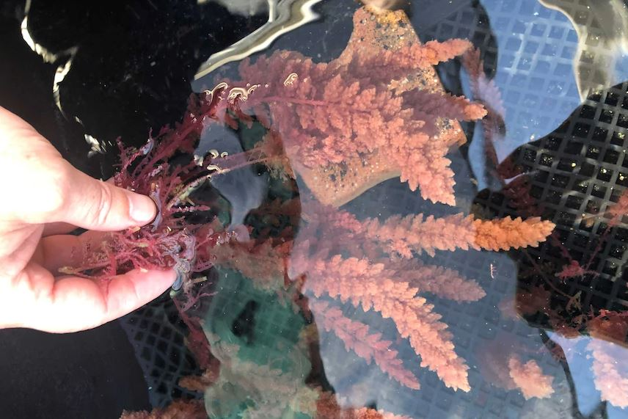
Potential strategies with anti-methanogenics Emissions reduction potential of using Asparagopsis in t CO2‑e
Emission type | Current emission | Potential emission | Reduction potential
Direct livestock enteric methane (feeding 6 months) | 1508 | 754* | 50%
Direct livestock enteric methane (feeding 12 months) | 1508 | 30* | 98%
Note. *Inclusion rate of 0.385% of dry matter intake based on Kinley et al. 2020.

Slide 22
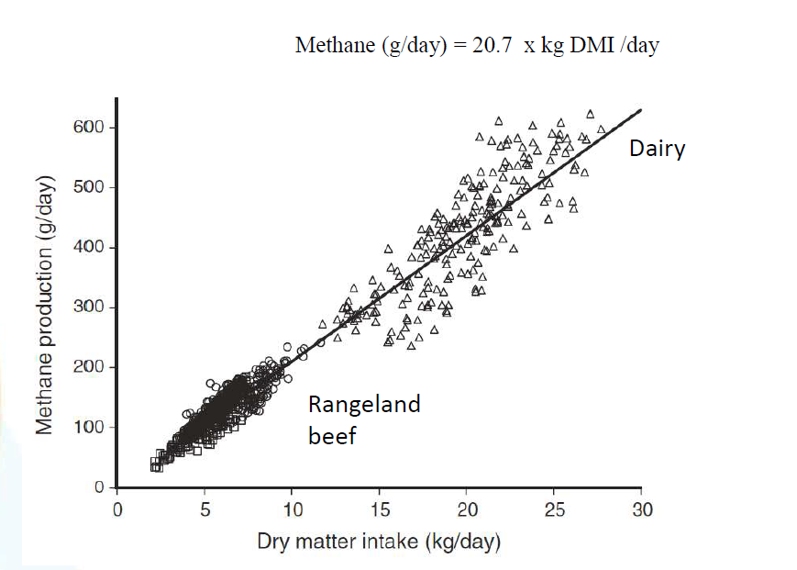
Its about what they eat!
8-20 kgCO2e/t MS

Slide 23
Nett Emissions 2019
 |  | Gg (1000 tonnes)
Livestock | Cattle methane & waste | 3,507
 | sheep methane & waste | 2,707
 | other livestock | 260
 | total Livestock | 6,474
Crops and pastures | Direct Soil Emissions | 1,911
 | Indirect Soil Emissions | 462
 | Field Burning of Agricultural Residues | 54
 | Liming | 674
 | Urea Application | 292
 | total crops and soils | 3,392
total agricultural emissions WA (2019) |  | 9,867
LULUC on private (ag) land Estimated
 | Forest remaining forest
 | Land to forest | -7075
 | Cropland remaining cropland | -5541
 | land converted to cropland | 1020
 | Grassland remaining grassland | -1770
 | Land converted to grassland | 3068
total emissions: private land estimated WA (2019) |  | -9203*
assumed no ag & pastoral land regeneration/degradation (state 1095.25)
assumed all plantations on farmland are owned by farm managers
crop type (incl perm hort), rotations, tillage, green manures, soil ameliorants, soil carbon, N2O emissions from fert and managed soils
land changed from something to crop and pasture
carbon sequestration on permanent grasslands (pastoral & high rainfall pastures) fire and grazing pressure
assumed no land converted to grassland - need to look at where the 3067.71 comes from

